Slide 1
Place Matters: Mapping Community Loss as a New Social Indicator
Mimi Abramovitz Bertha Capen Reynolds Professor of Social Policy, Silberman School of Social Work, Hunter College, CUNY
Jochen Albrecht Associate Professor of Geography, Department of Geography, Hunter College. CUNY

Slide 2
The Community Loss Index (CLI): A New Social Indicator
Place Matters: CLI recognizes the role of “place” as an aggregator of individual experiences. Helps us to understand what happens when large numbers of people living in close proximity regularly suffer multiple, persist losses at the same time.

Slide 3
Unpacking Poverty
Why are health and social problems concentrated in some but not other neighborhoods? 1. The Behavior of the Residents vs. 2. High Poverty Rates in Poor Neighborhoods But what about poverty leads people to harm themselves or others? ( our definition of social problems)
What is the pathway between adverse neighborhood conditions and the spatial concentration of health and social problems?

Slide 4
Stress as a Pathway
Well Known: Exposure to severe loss can create health and social problems for individuals. Less Well Known: What happens to communities in which large numbers of people living in close proximity regularly suffer multiple resource losses at the same time. The CLI Corrective: Aggregates individual experiences, and helps to understand why heath and social problem amasses in certain areas.

Slide 5
The Community Loss Index
I. Loss or Removal of Household Members due to
Foster care placement Incarceration Long-term hospitalization Untimely deaths (e.g., murders, suicides, and accidents)
II. Loss of Financial Assets due to Unemployment (job loss) Foreclosure ( loss of housing) ALL six losses (a) tend to be unpredictable and uncontrollable and thus (b) appear at the high end of the stress spectrum.

Slide 6
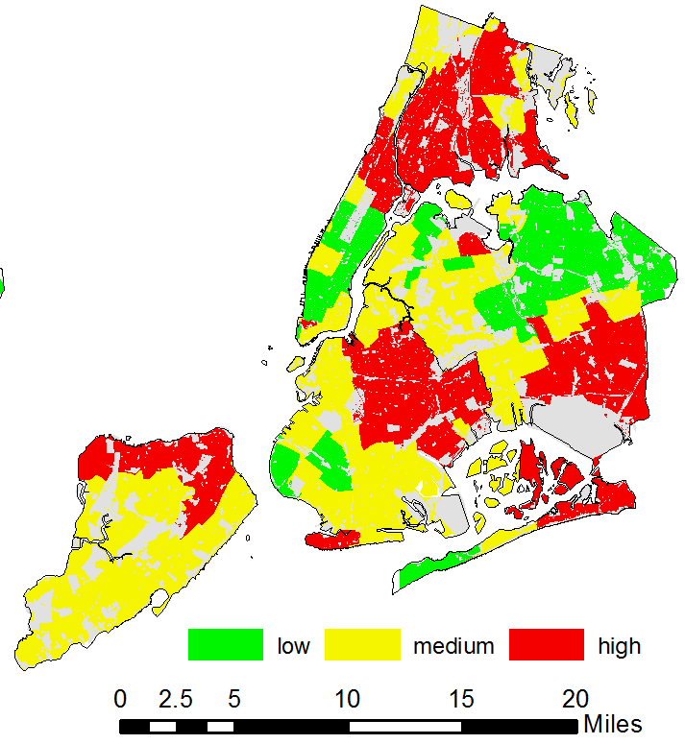
Citywide: Accumulated Community Loss
The sum of
Foster care placements
Incarcerations
Long term hospitalizations
Untimely Deaths
Foreclosures
Unemployment ----------------------
Red= high loss area Yellow=medium loss area Green=low loss area

Slide 7
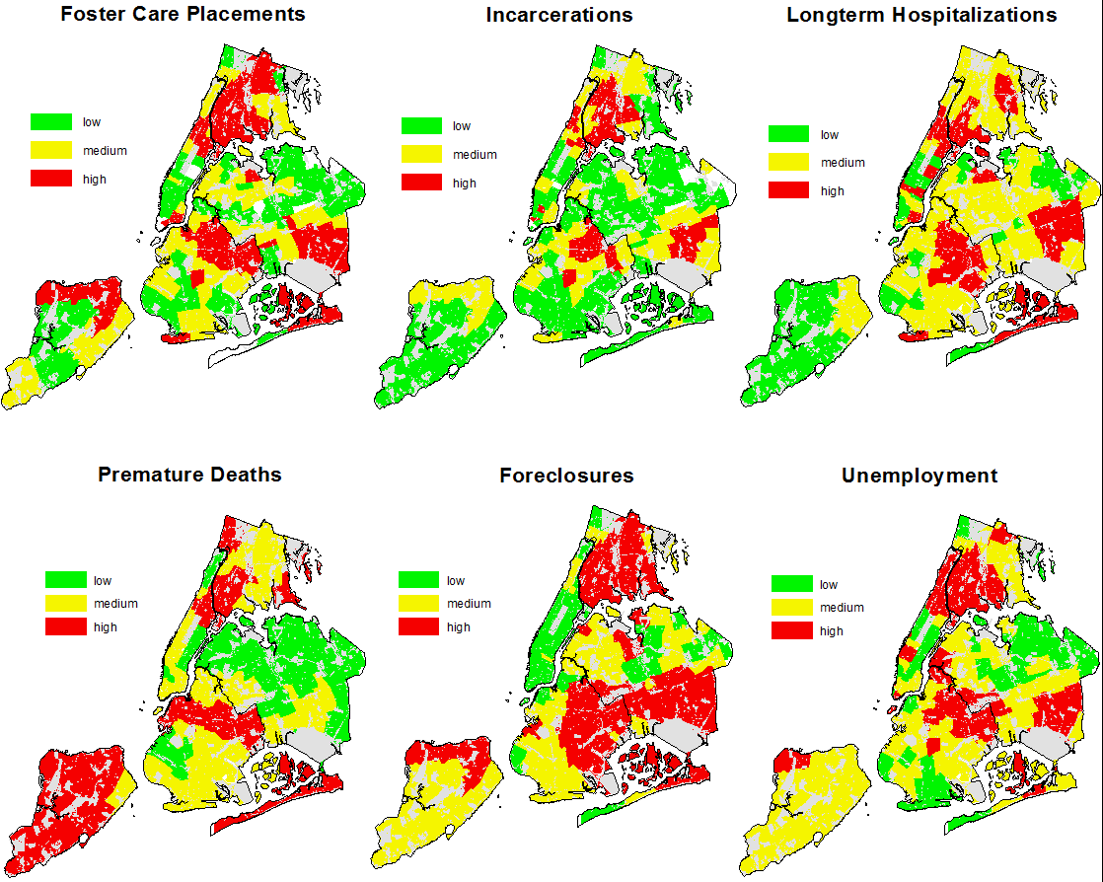
Citywide: Distribution of Losses

Slide 8
Figure 1: Citywide Low Loss (A) vs. High Loss Areas( B)
Notes:
The spread indicated by the whisker diagram suggests variation The maximum and the minimum observed values which are marked by the top and bottom lines indicate that the average loss (height of the bar) does not represent all the ZIP codes in the area and that the contribution of each loss is somewhat variable.
I need some help with the discussion of the top and bottom lines. Not what they represent, but that they MEAN
A: Although on average, the losses are quite moderate in the low loss areas, there are a number of census tracts even in those areas that experience above average losses (albeit never at the most extreme level). As is to be expected, the low loss areas are home to the lowest possible observed losses (value 1).
B: Except for long-term hospitalizations, the high loss areas are home to the worst-off census tracts for each of the loss types. On the other hand, even in the high loss areas, there are always (except for foster care placements) some census tracts that experience relatively low losses (value range 1-3).

Slide 9
Figure 2 Low Loss (A) vs. High Loss (B) Neighborhoods

Slide 10
People in Place Low Loss (A) vs. High Loss (B) Areas (Fig 4)
A
B

Slide 11
Figure 5: People in Place Low Loss (A) vs. High Loss (B) Neighborhoods

Slide 12
Application of CLI
Effectively captures a previously unrecognized component of community life and poverty. Disrupts the view of poverty as a uniform experience. Can help communities and public officials to: Unpack poverty in the context of place Understand how community loss varies by geography & demographics (place & persons) Work together to fine-tune intervention for change based on actual community needs..

